Slide 1
Workshop on computer vision for chemists: classification and detection of amoebae using optical microscopy images with machine learning
10/2022
Baosen Zhang
Advisor: Dr. Aliaksei Boika
Department of chemistry
The University of Akron, Akron, OH 44325

Slide 2
Outline
Introduction
Amoebae
Machine learning (ML) and computer vision (CV)
Platform: Google Colab and Jetson Nano
Prerequisite: Python basics and data analysis
Workshop schedule
Section 1: Image classification in Google Colab
Fundamentals of convolutional neural network
Keras introduction
Colab Notebook: Example, assignment and solution
Colab Notebook code details
Section 2: Object detection in Google Colab
Fundamentals of object detection
Mask R-CNN introduction
Colab Notebook: Example, assignment and solution
Colab Notebook code details
Section 3: Object detection in Jetson Nano
Fundamentals of SSD
Linux command line basics
Example

Slide 3
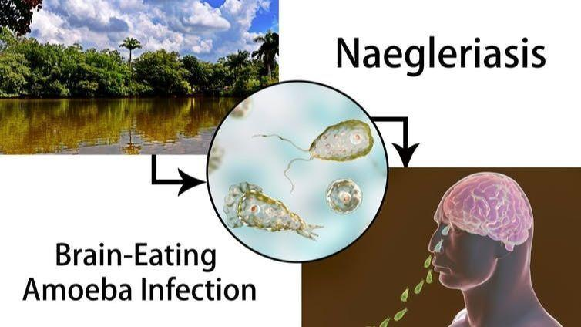
Introduction
Amoeba
Amoebae: single-cell organisms that exhibit amoeboid movement, i.e., movement via protrusion of cytoplasm of the cell.
Amoeba in this work: harmless A. proteus; harmful N. fowleri.
Importance of detecting amoeba:
N. fowleri, also called ‘the brain-eating amoeba’, is a global health concern.
The common detection method is microscopic observation, which is a simple but tedious task which requires highly trained personnel.
Machine learning can make the autonomous observation.
https://theconversation.com/why-the-brain-eating-amoeba-found-in-freshwater-lakes-while-rare-is-so-deadly-121171

Slide 4


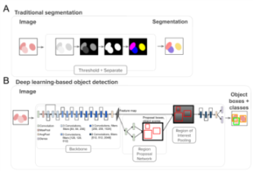
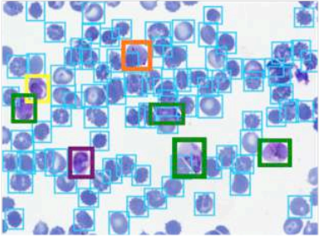
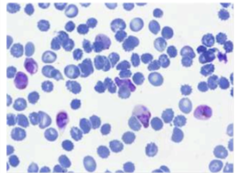
Introduction
Machine learning (ML):
ML is a computer algorithm that it can build a model based on training data, and the trained model can be used to make predictions.
Computer vision (CV):
ML can be used in the field of CV that trains computers to understand the visual world.
Successful applications: face detection, hand gesture detection
Can be used in Microscopic world.
Image data
Trained model
prediction
Hung, J. and Carpenter, A., 2017. Applying faster R-CNN for object detection on malaria images. In Proceedings of the IEEE conference on computer vision and pattern recognition workshops (pp. 56-61).

Slide 5
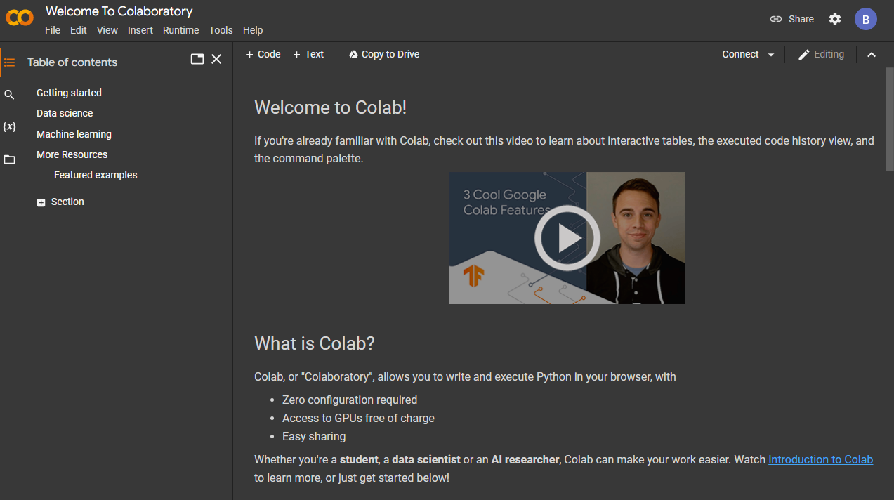
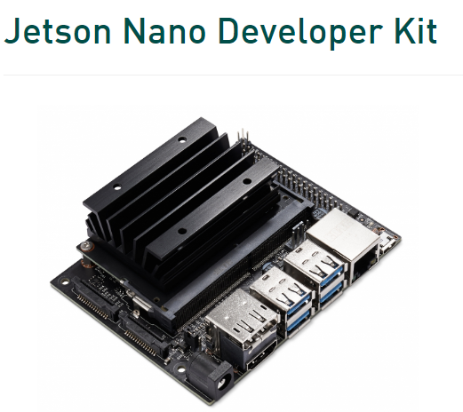
Introduction
Platform: Google Colab
Colab, or "Colaboratory", allows you to write and execute Python in your browser, with Zero configuration required, Access to GPUs free of charge, Easy sharing.
Platform: Jetson Nano
NVIDIA® Jetson Nano™ Developer Kit is a small, powerful computer that lets you run neural networks for applications like image classification, object detection, segmentation,
https://colab.research.google.com/?utm_source=scs-index&hl=en
https://developer.nvidia.com/embedded/jetson-nano-developer-kit

Slide 6
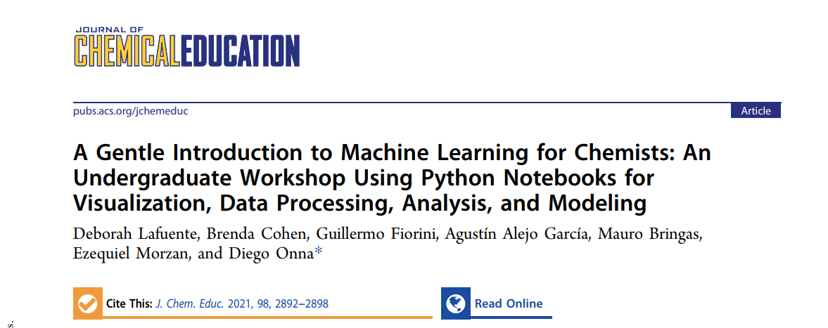
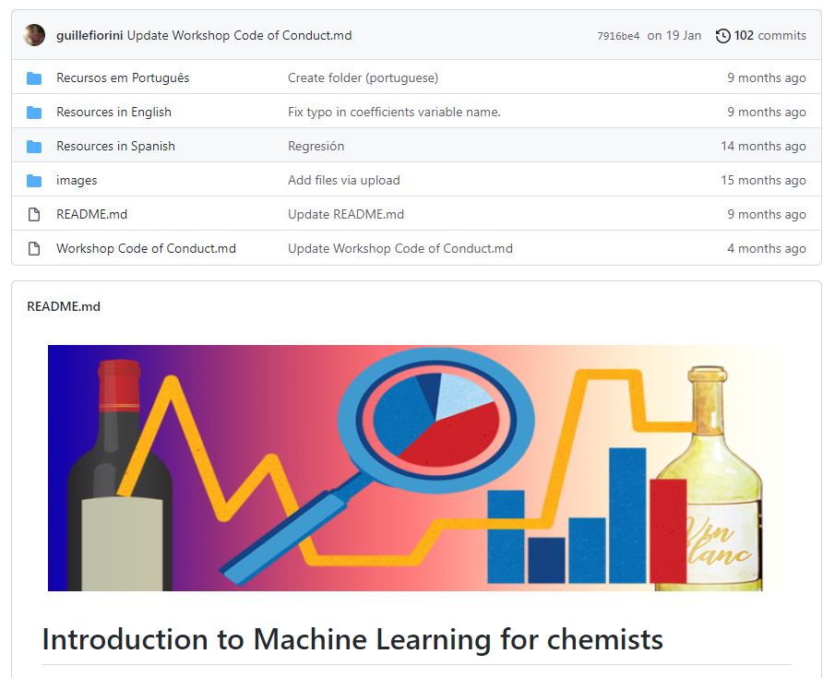
Introduction
Prerequisite: Python Basics and data analysis
Learning resources:
The Chemical education paper in the right.
McKinney, W., 2012. Python for data analysis: Data wrangling with Pandas, NumPy, and IPython. " O'Reilly Media, Inc.".
More learning resources and their introductions are listed in our supporting information.
Lafuente, D., Cohen, B., Fiorini, G., García, A.A., Bringas, M., Morzan, E. and Onna, D., 2021. A Gentle Introduction to Machine Learning for Chemists: An Undergraduate Workshop Using Python Notebooks for Visualization, Data Processing, Analysis, and Modeling. Journal of Chemical Education, 98(9), pp.2892-2898.

Slide 7
Introduction
Workshop schedule
Introduction
Section 1: Image classification in Google Colab
Fundamentals (ppt presentation)
Clothes classification (Example Colab Notebook)
Amoeba classification (Assignment and solution Colab Notebook)
Section 2: Object detection in Google Colab
Fundamentals (ppt presentation)
Kangaroo detection (Example Colab Notebook)
Amoeba detection(Assignment and solution Colab Notebook)
Section 3: Object detection in Jetson Nano
Fundamentals (ppt presentation)
Amoeba detection (Example)
Goodbye and Future plan
Workshop Survey

Slide 8
Let’s look at our source code on GitHub, tutorials video in YouTube.

Slide 9
Outline
Introduction
Amoebae
Machine learning (ML) and computer vision (CV)
Platform: Google Colab and Jetson Nano
Prerequisite: Python basics and data analysis
Workshop schedule
Section 1: Image classification in Google Colab
Fundamentals of convolutional neural network
Keras introduction
Colab Notebook: Example, assignment and solution
Colab Notebook code details
Section 2: Object detection in Google Colab
Fundamentals of object detection
Mask R-CNN introduction
Colab Notebook: Example, assignment and solution
Colab Notebook code details
Section 3: Object detection in Jetson Nano
Fundamentals of SSD
Linux command line basics
Example

Slide 10
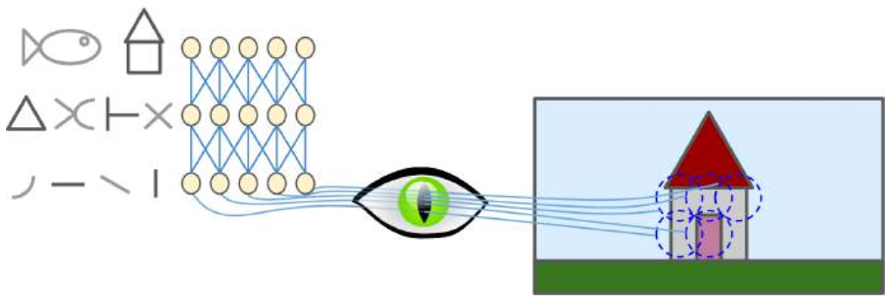
Section 1: Image classification in Google Colab
Convolutional neural network (CNN)
Local receptive fields
Visual cortex: many neurons in the visual cortex have a small local receptive field, meaning they react only to visual stimuli located in a limited region of the visual field.
First CNN architecture: An important milestone was a 1998 paper by Yann LeCun, etc., which introduced the famous LeNet-5 architecture, widely used to recognize handwritten check numbers. It introduces two new building blocks: convolutional layers and pooling layers.
Géron, A., 2019. Hands-on machine learning with Scikit-Learn, Keras, and TensorFlow: Concepts, tools, and techniques to build intelligent systems. " O'Reilly Media, Inc.".

Slide 11
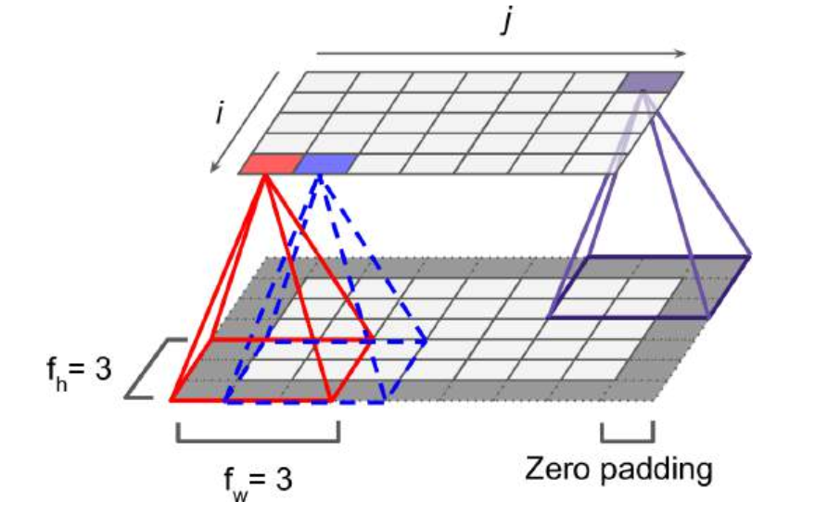
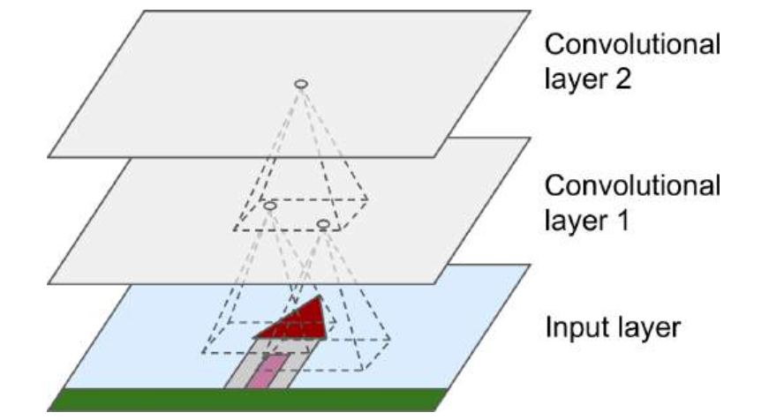
Section 1: Image classification in Google Colab
Convolutional layer
Convolutional layer: the most important building block (array) of a CNN. Neurons in first convolutional layer are connected to pixels in receptive fields in input layer. Concentrate on small low-level features in the first hidden layer, then assemble them into larger higher-level features in the next hidden layer.
Stride: The shift from one receptive field to the next.
Zero padding: In order for a layer to have the same height and width as the previous layer, it is common to add zeros around the inputs.
Filter (convolutional kernels): a neuron’s weights can be represented as a small image the size of the receptive field.
Feature map: highlights the area in an image that activate the filter the most.
Géron, A., 2019. Hands-on machine learning with Scikit-Learn, Keras, and TensorFlow: Concepts, tools, and techniques to build intelligent systems. " O'Reilly Media, Inc.".

Slide 12
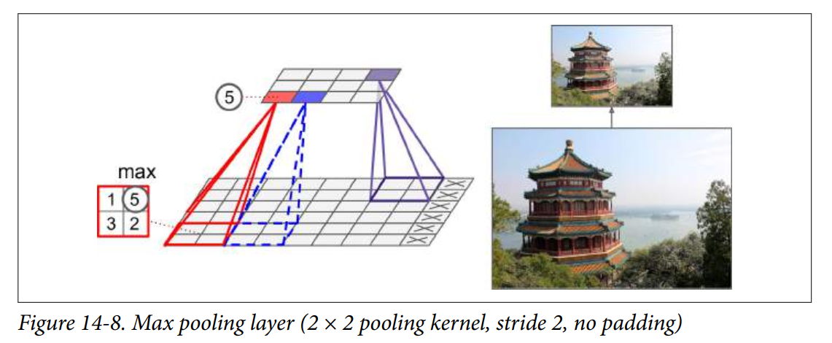
Section 1: Image classification in Google Colab
Pooling layer
The goal of pooling layer is to subsample (i.e., shrink) the input image in order to reduce the computational load, the memory usage, and the number of parameters.
Géron, A., 2019. Hands-on machine learning with Scikit-Learn, Keras, and TensorFlow: Concepts, tools, and techniques to build intelligent systems. " O'Reilly Media, Inc.".

Slide 13
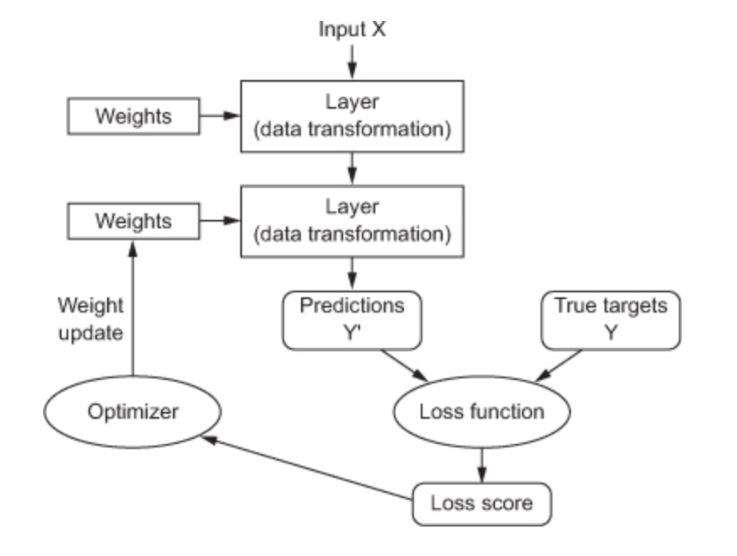
Section 1: Image classification in Google Colab
Model compile
Loss function: compute loss score that is used as a feedback to adjust the weights. (https://keras.io/api/losses/)
Optimizer: a function that modifies the attributes of the neural network, such as weights and learning rate. Thus, it helps in reducing the overall loss and improve the accuracy. (https://keras.io/api/optimizers/)
Metric: a function that is used to judge the performance of your model. (https://keras.io/api/metrics/)
https://kevin-kotze.gitlab.io/tsm/ts-18-note/

Slide 14
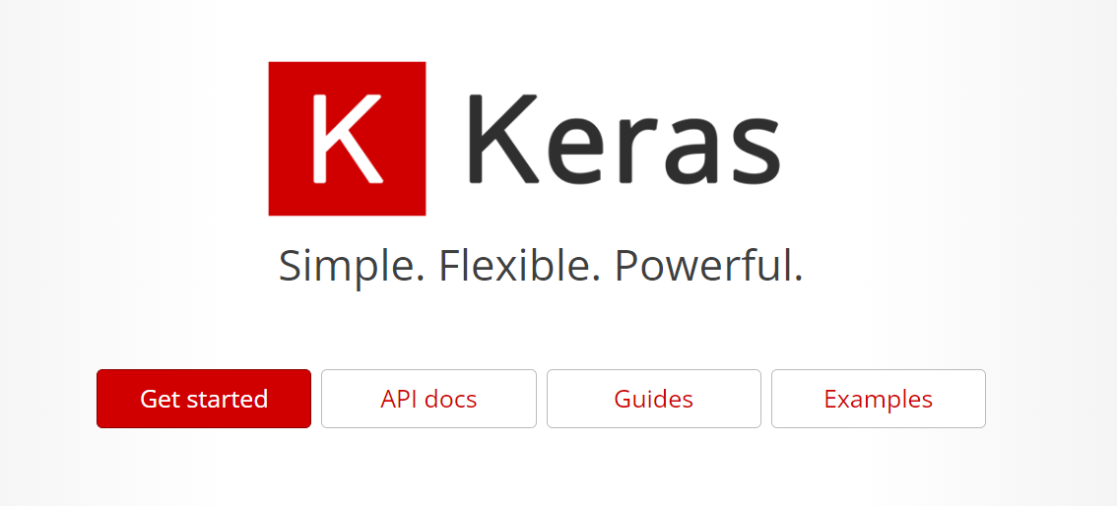
Section 1: Image classification in Google Colab
Keras Introduction
Keras is a deep learning API written in Python, running on top of the machine learning platform TensorFlow. It was developed with a focus on enabling fast experimentation.
https://keras.io/

Slide 15
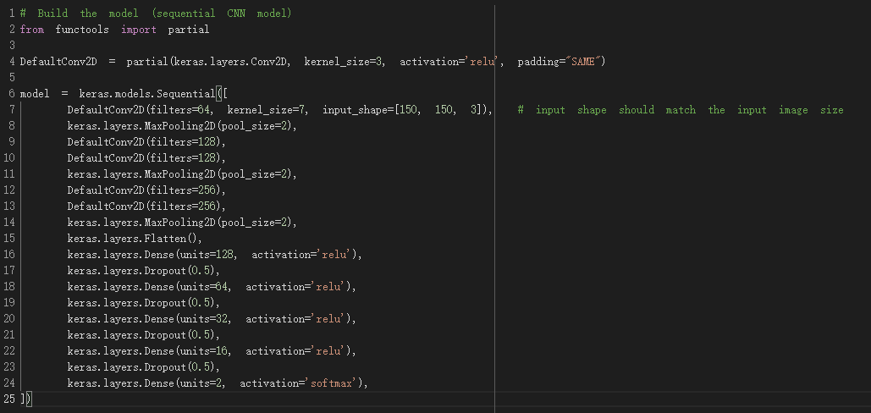
Section 1: Image classification in Google Colab
Keras introduction
https://keras.io/
Géron, A., 2019. Hands-on machine learning with Scikit-Learn, Keras, and TensorFlow: Concepts, tools, and techniques to build intelligent systems. " O'Reilly Media, Inc.".

Slide 16
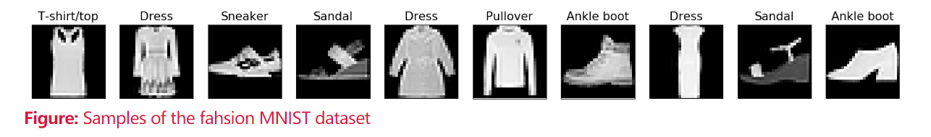
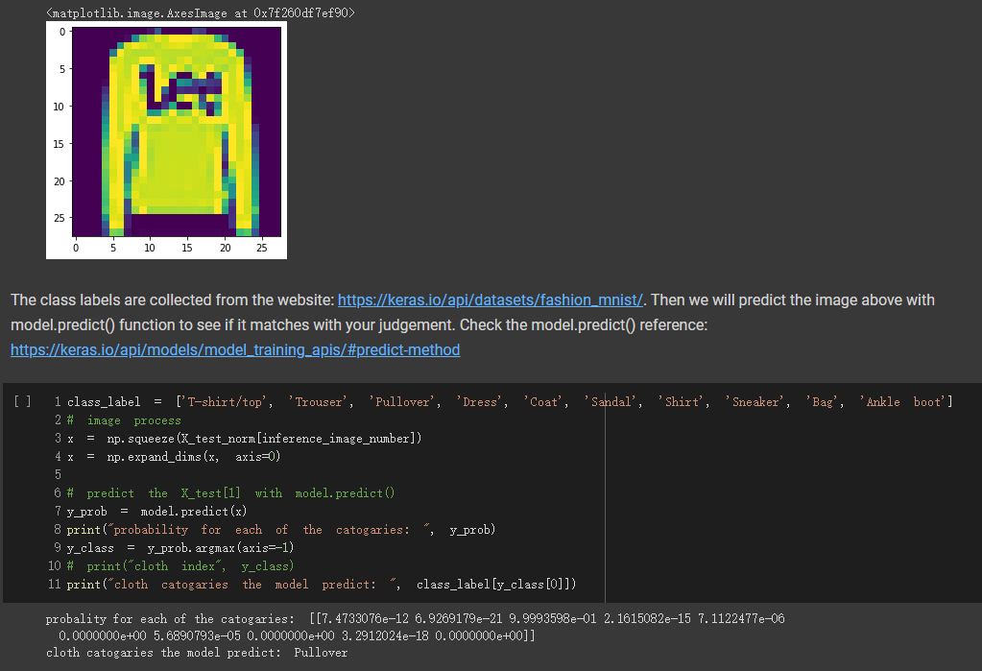

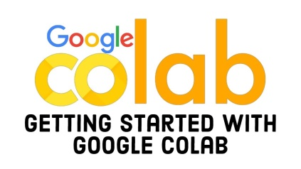
Section 1: Image classification in Google Colab
Colab Notebook: Example regarding Clothes classification
prediction
Trained model
https://teaching.pages.centralesupelec.fr/deeplearning-lectures-build/00-pytorch-fashionMnist.html

Slide 17
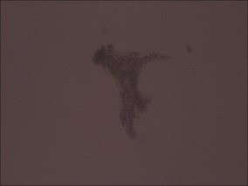
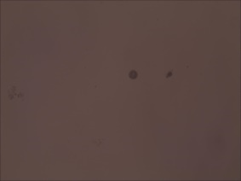
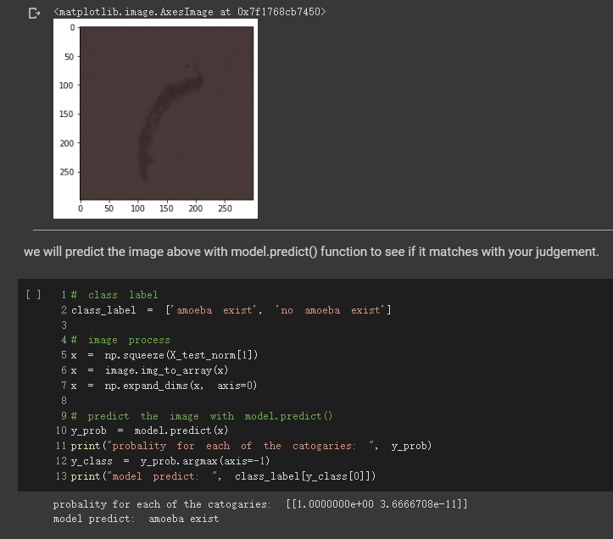
Section 1: Image classification in Google Colab
Colab Notebook: Assignment and solution regarding amoeba classification
Amoeba exist
No amoeba exist
prediction
Trained model
https://teaching.pages.centralesupelec.fr/deeplearning-lectures-build/00-pytorch-fashionMnist.html

Slide 18
Section 1: Image classification in Google Colab
Let’s learn how to open the Google Colab and look at Colab Notebook in details!

Slide 19
Outline
Introduction
Amoebae
Machine learning (ML) and computer vision (CV)
Platform: Google Colab and Jetson Nano
Prerequisite: Python basics and data analysis
Workshop schedule
Section 1: Image classification in Google Colab
Fundamentals of convolutional neural network
Keras introduction
Colab Notebook: Example, assignment and solution
Colab Notebook code details
Section 2: Object detection in Google Colab
Fundamentals of object detection
Mask R-CNN introduction
Colab Notebook: Example, assignment and solution
Colab Notebook code details
Section 3: Object detection in Jetson Nano
Fundamentals of SSD
Linux command line basics
Example

Slide 20
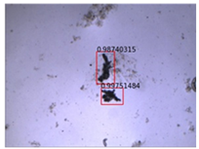
Section 2: Object detection in Google Colab
Fundamentals of object detection
Object detection: aims at locating and classifying existing objects in any one image, and labeling them with rectangular bounding box to show the confidences of existence.
Frameworks of object detection methods
Region proposal based methods: | Regression/classification based methods:
R-CNN (Region-based Convolutional Neural Network) Fast R-CNN Faster R-CNN Mask R-CNN (Section 2) | You only look once (YOLO) Single shot detector (SSD) (Section 3)
Zhao, Z.Q., Zheng, P., Xu, S.T. and Wu, X., 2019. Object detection with deep learning: A review. IEEE transactions on neural networks and learning systems, 30(11), pp.3212-3232.

Slide 21
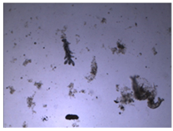
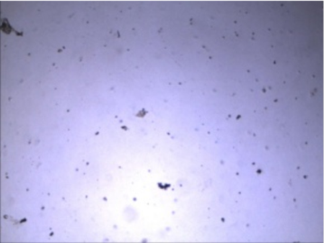
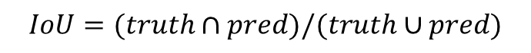
Section 2: Object detection in Google Colab
Fundamentals of object detection – model evaluation
Confusion matrix and Intersection over Union (IoU)
Intersection over Union (IoU)
Actual
$$IoU=(truth∩pred)/(truth∪pred)$$
Positive
Negative
IoU is in the range from 0 to 1.
Positive
True Positive (TP): The IoU value is above the threshold.
False Positive (FP): If the model gives a predicted bounding box but the IoU value is below the threshold.
False Negative (FN): If there is truth object but the object is not detected.
True Negative (TN): If there is no predicted bounding box and no truth object.
TP
FP
Predicted
Negative
FN
TN
Solid box: labeled
Dotted box: predicted

Slide 22
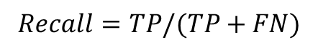
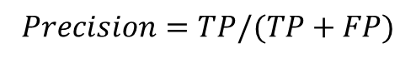
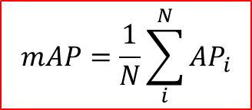
Section 2: Object detection in Google Colab
Fundamentals of object detection – model evaluation
Recall and precision
$$Recall=TP/(TP+FN)$$
$$Precision=TP/(TP+FP)$$
Average precision (AP)
AP is to find the area under the precision-recall curve.
mean average precision (mAP)
$$mAP=\frac{1}{N}\sum_{i}^{N}{{AP}_{i}}$$
N is number of classes.
mAP is in the range between 0 and 1.

Slide 23
Section 2: Object detection in Google Colab
Mask R-CNN
Raw image
Backbone (CNN)
RPN (Region proposal network): scan the feature map and proposing regions that may have objects in them (Region of Interest or RoI)
RoIAlignment (Region of Interest alignment): extracts feature from a feature map based on RoI proposed by RPN, and turn them into a fix-sized tensor for further processes.
Feature map
RPN
RoIAlignment
Object Detection head
Mask generation head
Class
Box
Mask
https://www.shuffleai.blog/blog/Understanding_Mask_R-CNN_Basic_Architecture.html
He, K., Gkioxari, G., Dollár, P. and Girshick, R., 2017. Mask r-cnn. In Proceedings of the IEEE international conference on computer vision (pp. 2961-2969).

Slide 24
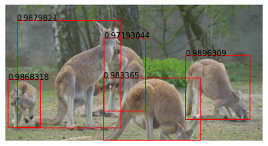
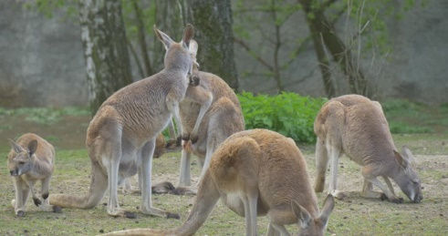
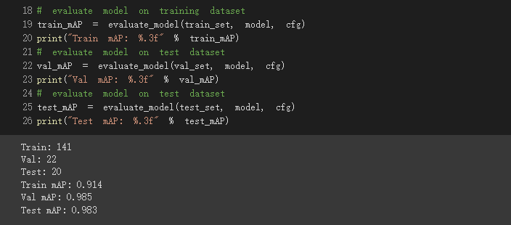
Section 2: Object detection in Google Colab
Colab Notebook: Example regarding Kangaroo detection
Mask R-CNN
Image data
prediction

Slide 25
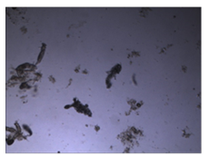
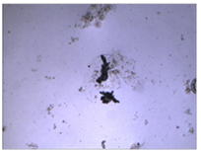
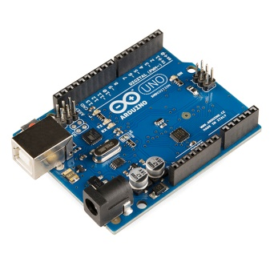
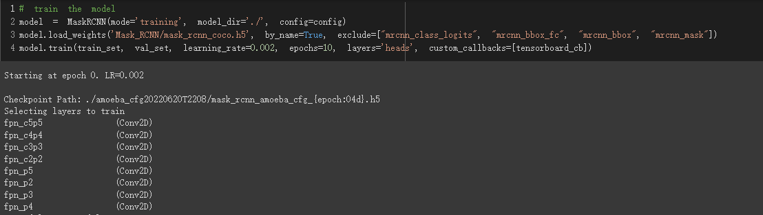
Section 2: Object detection in Google Colab
Colab Notebook: Assignment and Solution about Amoeba detection
Image data
Mask R-CNN
prediction
Image collect Automation

Slide 26
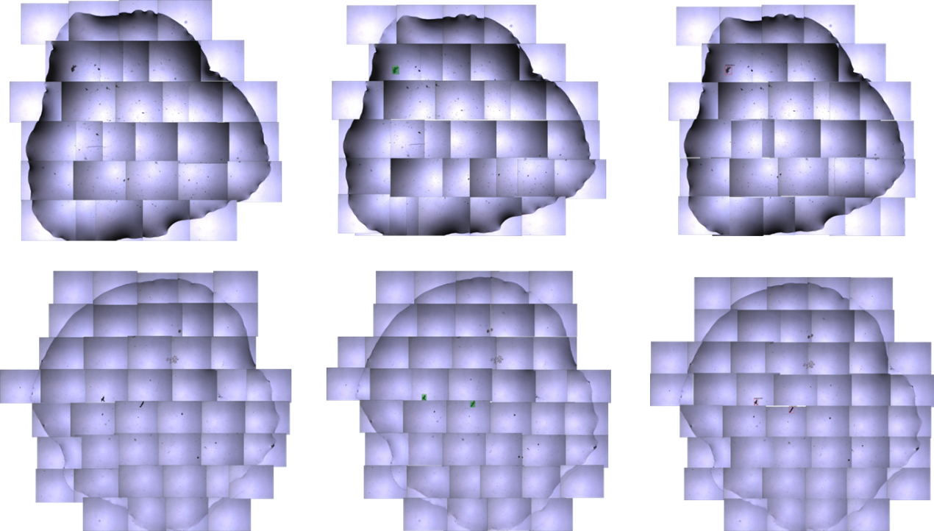
Section 2: Object detection in Google Colab
Colab Notebook: Assignment and Solution about Amoeba detection
original
Mask R-CNN inference

Slide 27
Section 2: Object detection in Google Colab
Let’s look at Colab Notebook in details!

Slide 28
Outline
Introduction
Amoebae
Machine learning (ML) and computer vision (CV)
Platform: Google Colab and Jetson Nano
Prerequisite: Python basics and data analysis
Workshop schedule
Section 1: Image classification in Google Colab
Fundamentals of convolutional neural network
Keras introduction
Colab Notebook: Example, assignment and solution
Colab Notebook code details
Section 2: Object detection in Google Colab
Fundamentals of object detection
Mask R-CNN introduction
Colab Notebook: Example, assignment and solution
Colab Notebook code details
Section 3: Object detection in Jetson Nano
Fundamentals of SSD
Linux command line basics
Example

Slide 29
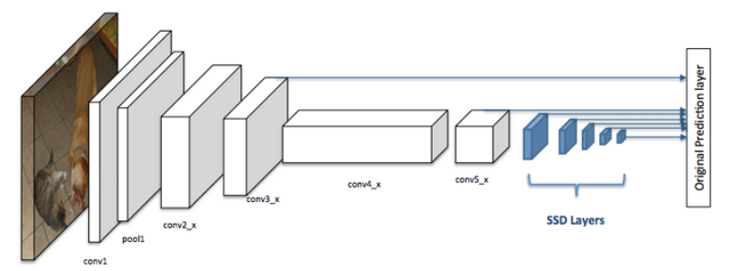
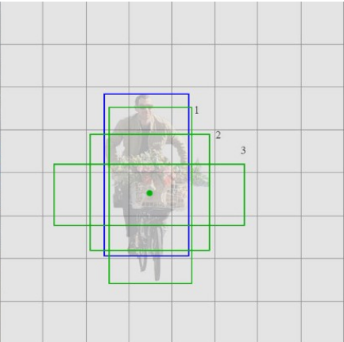
Section 3: Object detection in Jetson Nano
Fundamentals of SSD
SSD structure: Backbone model (CNN) and SSD head.
Grid cell to predict the class. Default bounding box has higher IoU with ground truth bounding box to detect the object.
Multi-scale feature maps and aspect ratio to detect different shapes and size of object.
SSD find all objects within an image in one pass (hence ‘single-shot’) through the additional convolutional layer.
SSD is designed for object detection in real-time.
https://developers.arcgis.com/python/guide/how-ssd-works/
https://jonathan-hui.medium.com/ssd-object-detection-single-shot-multibox-detector-for-real-time-processing-9bd8deac0e06
Liu, W., Anguelov, D., Erhan, D., Szegedy, C., Reed, S., Fu, C.Y. and Berg, A.C., 2016, October. Ssd: Single shot multibox detector. In European conference on computer vision (pp. 21-37). Springer, Cham.

Slide 30
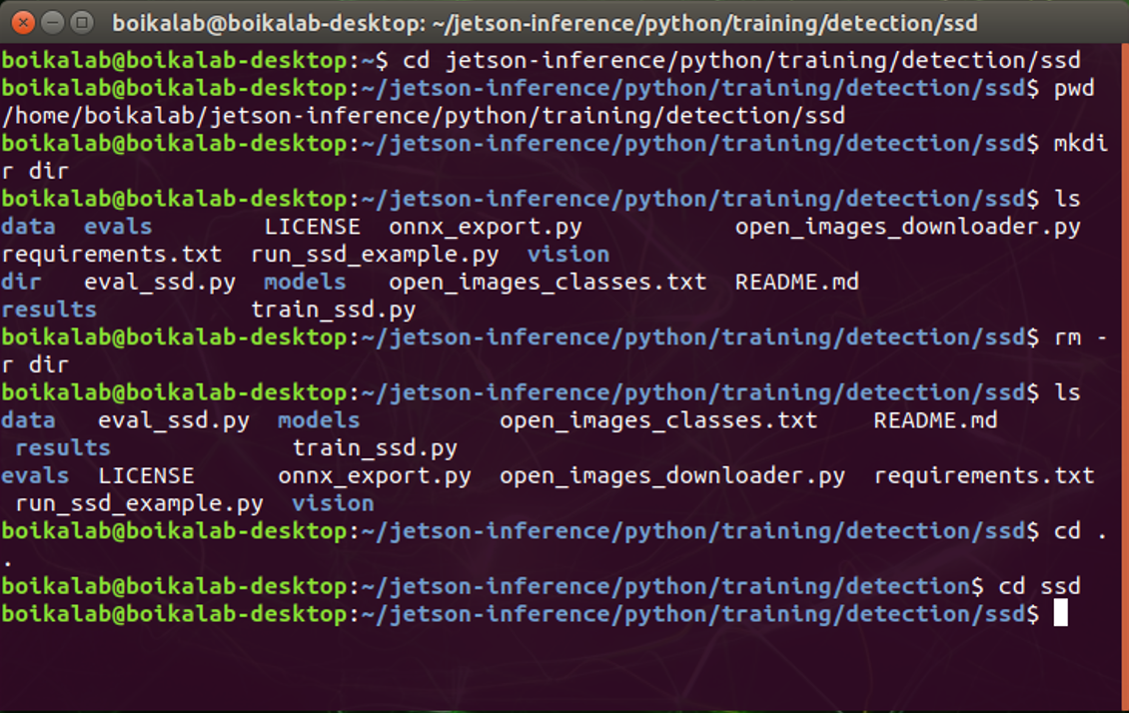
Section 3: Object detection in Jetson Nano
The Linux command line basics
The Linux command line is a text interface to your computer.
It can let us understand more underlying logic of the computer.
The command can finish tasks like changing directories (cd), listing the contents (ls), moving files (mv), and so on.
https://ubuntu.com/tutorials/command-line-for-beginners#9-conclusion

Slide 31
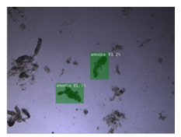
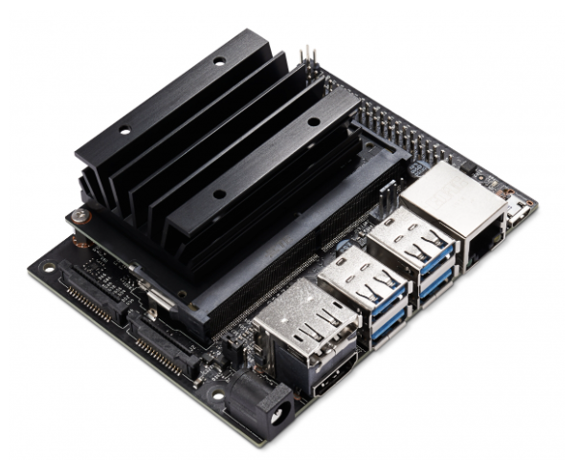
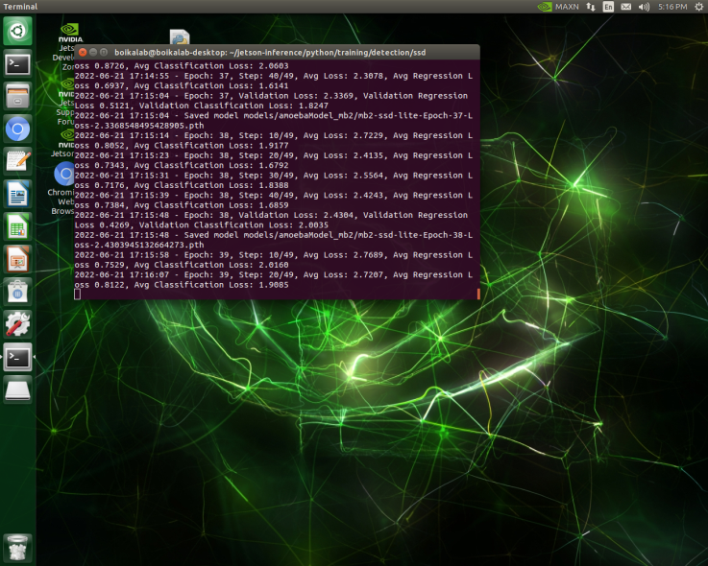
Section 3: Object detection in Jetson Nano
Example: amoeba detection
Image data
Inference
SSD-Mobilenet
Image collect Automation

Slide 32
Section 3: Object detection in Jetson Nano
Example: amoeba detection
Original
SSD-MobileNet

Slide 33
Section 3: Object detection in Jetson Nano
Let’s start to explore Jetson Nano!

Slide 34
Future plan
Section 2 Bonus and Section 3 Bonus
This great book is to give you the concepts, the intuitions, and the tools (Scikit-Learn, TensorFlow, Keras) you need to actually implement programs capable of learning from data: Géron, A., 2019. Hands-on machine learning with Scikit-Learn, Keras, and TensorFlow: Concepts, tools, and techniques to build intelligent systems. " O'Reilly Media, Inc.".
The course by Prof. Andrew Ng is the premier source of the initiation into the field of machine learning (https://www.coursera.org/learn/machine-learning). It covers many fundamental knowledge and math regarding machine learning.
This is the original source of Jetson inference. They provide detailed tutorials of how to use the Jetson Nano or other NVIDIA product to train or do inference: https://github.com/dusty-nv/jetson-inference.

Slide 35
Thanks

